Slide 1





MACHINE LEARNING
WORKSHOP
Transforming the Future
PRESENTED BY -

Slide 2






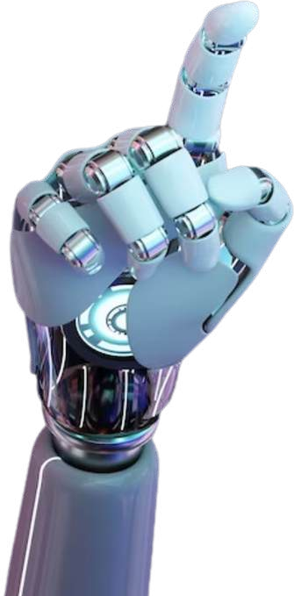

ML WORKSHOP SUMMARY
Introduction
Model Showcases (Fake News Detection and Chatbot) Pandas Briefing
ML Model Hands-On
Roadmap QfiA

Slide 3



INTRODUCTION

Slide 4






Machine Learning
Machine Learning is a subset of Artificial Intelligence (AI) that focuses on developing algorithms that enable computers to learn from data and make decisions without explicit programming.
Difference between AI and ML:
AI is the broader field; ML is one method to achieve AI.
Applications:
Image recognition speech processing fraud detection
personalized recommendations
ARTIFICIAL INTELLIGENCE
MACHINE LEARNING
DEEP LEARNING

Slide 5

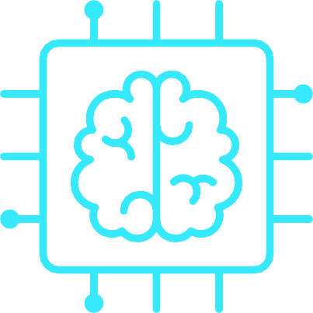





CURRENT TRENDS OF ML AND AI
GENERATIVE AI
AGENTIC AI
AI IN CYBERSECURITY
Generative AI creates new content—text, images, audio, or code—by learning from data and mimicking human creativity.
Text Generation – ChatGPT (AI chatbots fi content writing)
Code Generation – GitHub Copilot, OpenAI Codex (AI- assisted programming)
Agentic AI refers to AI systems that can think, decide, and act on their own to achieve goals—like a digital assistant that doesn’t just follow commands but figures out what to do next.
It often uses:
Reinforcement Learning Large Language Models
AI's role in cybersecurity is expanding, addressing challenges such as unauthorized AI tool usage ("shadow AI") and evolving threats from quantum computing and generative AI. Example:
Shadow AI – Unauthorized use of AI tools by employees, leading to security risks (e.g., data leaks via AI chatbots).

Slide 6


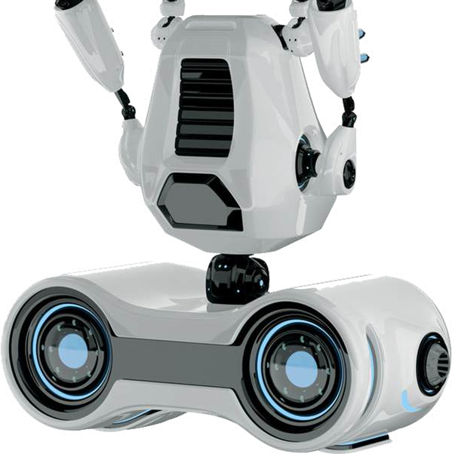

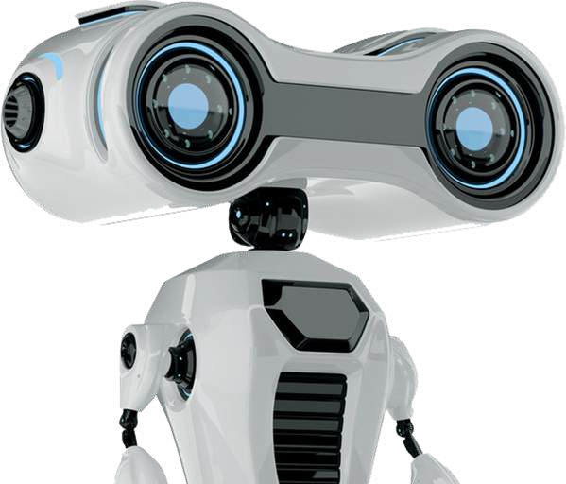

Transforming Learning
AI is revolutionizing education by providing personalized learning experiences, automating administrative tasks, and
enhancing teaching methods. AI-powered platforms can
learning styles, offering customized
adapt to individual
content and feedback. Additionally, AI assists educators in grading, tracking student progress, and identifying areas for improvement.
✅ Personalized Learning – AI platforms like Duolingo and Khan Academy adapt lessons based on student performance.
✅ AI Tutors fi Chatbots – Virtual tutors like Socratic by Google and ChatGPT help answer student queries.
✅ Automated Grading – AI tools like Gradescope assist teachers by grading assignments and detecting plagiarism.

Slide 7

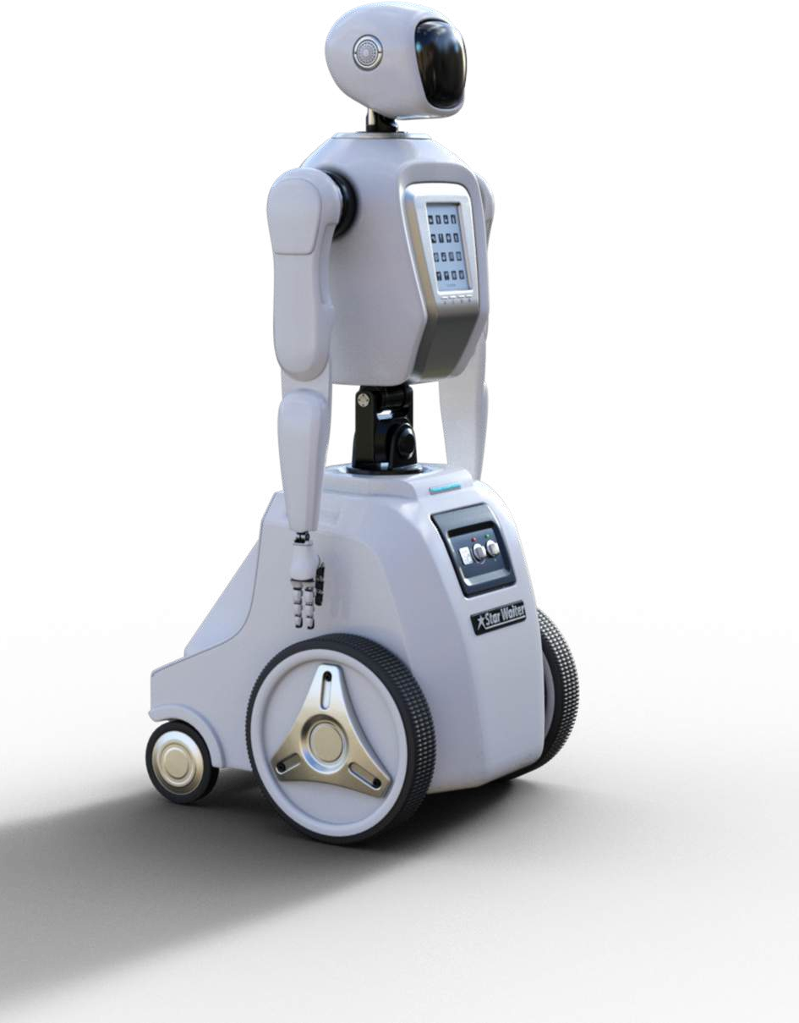
Revolutionizing Medicine
Enhancing Diagnostics: AI algorithms analyze medical images to detect conditions like cancer, heart disease, and other abnormalities.
Predicting Disease Outbreaks: AI models can predict the spread of diseases, helping with early intervention and resource planning.
Personalizing Treatment Plans: AI tailors treatment plans
based on individual patient data, ensuring more effective and targeted care.
Assisting in Drug Discovery: AI accelerates the process of
discovering new drugs by analyzing biological data and predicting drug efficacy.
Managing Patient Data: AI-powered tools help manage and
organize patient records, streamlining processes and improving data accuracy.

Slide 8




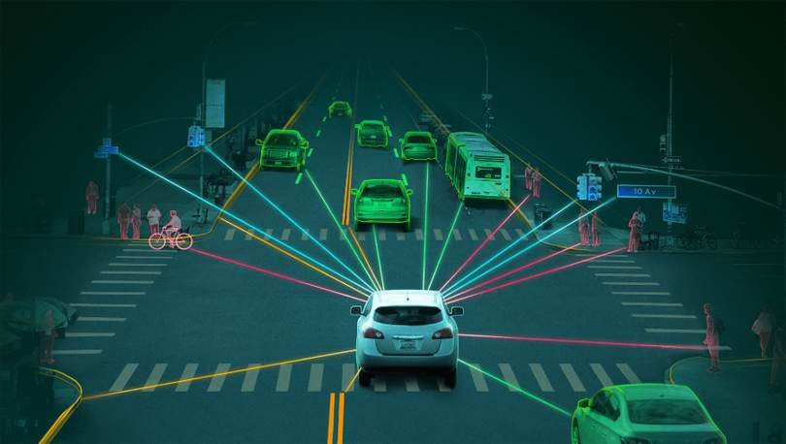
Smart Mobility
AI is at the forefront of transforming transportation through advancements in autonomous vehicles, traffic management, and logistics. Self-driving cars, powered by AI, are expected to reduce accidents and improve traffic flow. AI also optimizes routes for delivery services and enhances public transportation systems, making travel safer and more efficient.

Slide 9

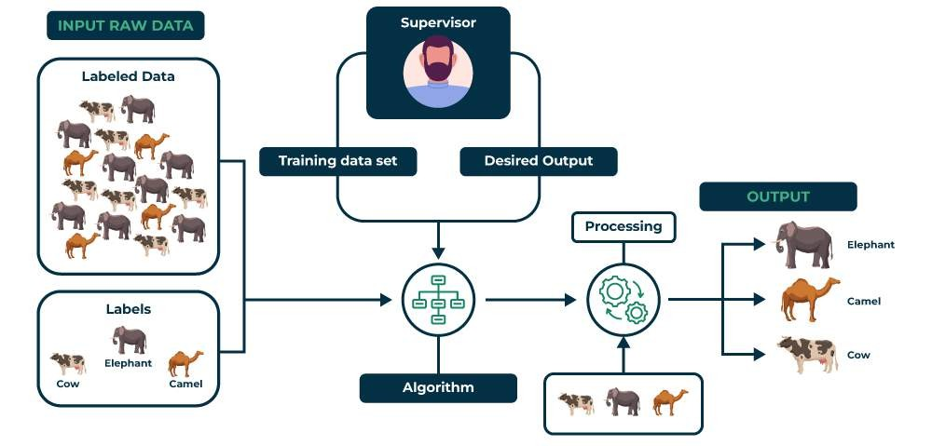

Branches of ML
1. Supervised Learning
Examples: Spam detection, Credit scoring.
Algorithms: Decision Trees, Random Forest, SVM, Neural Networks.

Slide 10
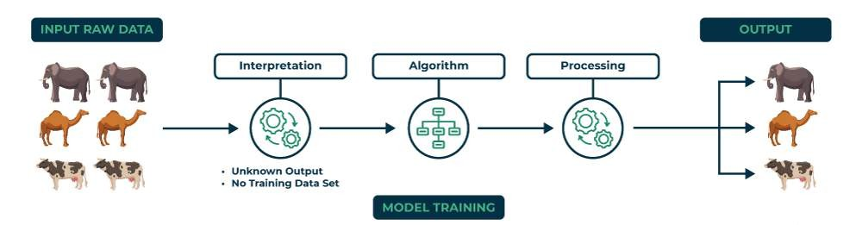
Branches of ML
2. Unsupervised Learning
Examples: Customer segmentation, Anomaly detection.
Algorithms: K-Means Clustering, Hierarchical Clustering, PCA.

Slide 11

Branches of ML
3. Reinforcement Learning
Examples: AlphaGo (AI for board games), Robotics, Self-driving cars. Algorithms: Q-Learning, Deep Q Networks, Policy Gradient Methods.

Slide 12



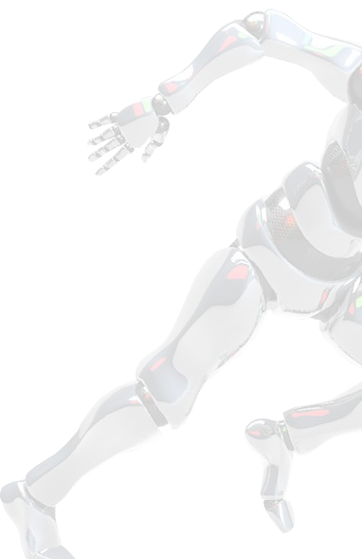

MODEL DEMONSTRATION

Slide 13
ROADMAP
Deep Learning
Python & its libraries
Agentic AI
Machine Learning
Generative AI

Slide 14
RESOURCES
Python Basics - Python Libraries -
Machine Learning - Playlist
Deep Learning - Playlist
Link
Link
Krish Naik CampusX
Krish Naik
CampusX
NLP Playlist-
Krish Naik
GenAI Playlist-
Krish Naik
Agentic AI Playlist-
Krish Naik

Slide 15






FUTURE SCOPE
Artificial General Intelligence (AGI)
AI systems that think and reason like humans.
Potential for AI to automate complex tasks beyond predefined rules.
AI-Powered Automation
AI transforming industries (Healthcare, Finance, Education, Manufacturing). Example: AI-powered legal advisors, AI detecting fake news.
AI Ethics & Regulations
AI Bias fi Fairness: Ensuring AI doesn’t discriminate.
AI Governance: Governments developing AI laws fi regulations.
AI in Space Exploration
AI assisting NASA fi ISRO in planetary exploration. AI-powered autonomous robots on Mars.
AI & The Evolution of Creativity
AI will generate new art forms, languages, and music beyond human imagination.
Example: An AI composing a completely new genre of music that no human has ever thought of, blending quantum harmonics with neural rhythms.

Slide 16


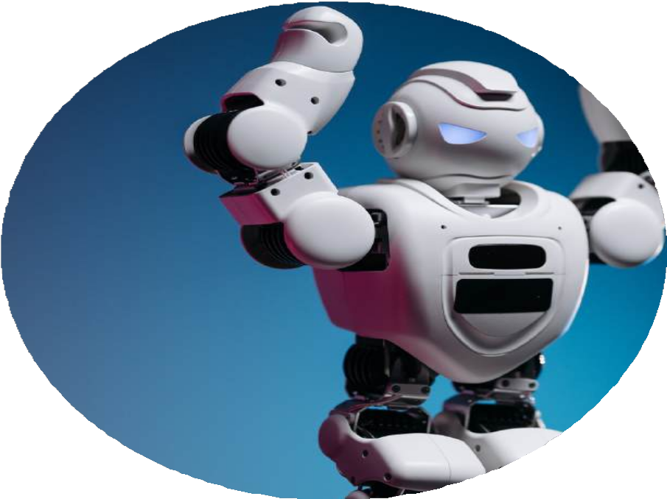

Challenges
  Data Quality & Bias – AI decisions depend on data, but biased or low- quality data leads to unfair outcomes.
  Explainability & Trust – Many AI models act as “black boxes,” making it hard to understand their decisions.
  High Computational Costs – Training large models requires immense processing power and energy.
  Adversarial Attacks – AI can be manipulated with small tweaks, leading to security vulnerabilities.(Prompt Injection)
  Ethical & Legal Concerns – AI use in surveillance, hiring, and policing raises human rights issues.
  Deepfakes & Misinformation – AI-generated content can spread false information and harm trust.
next slide

Slide 17


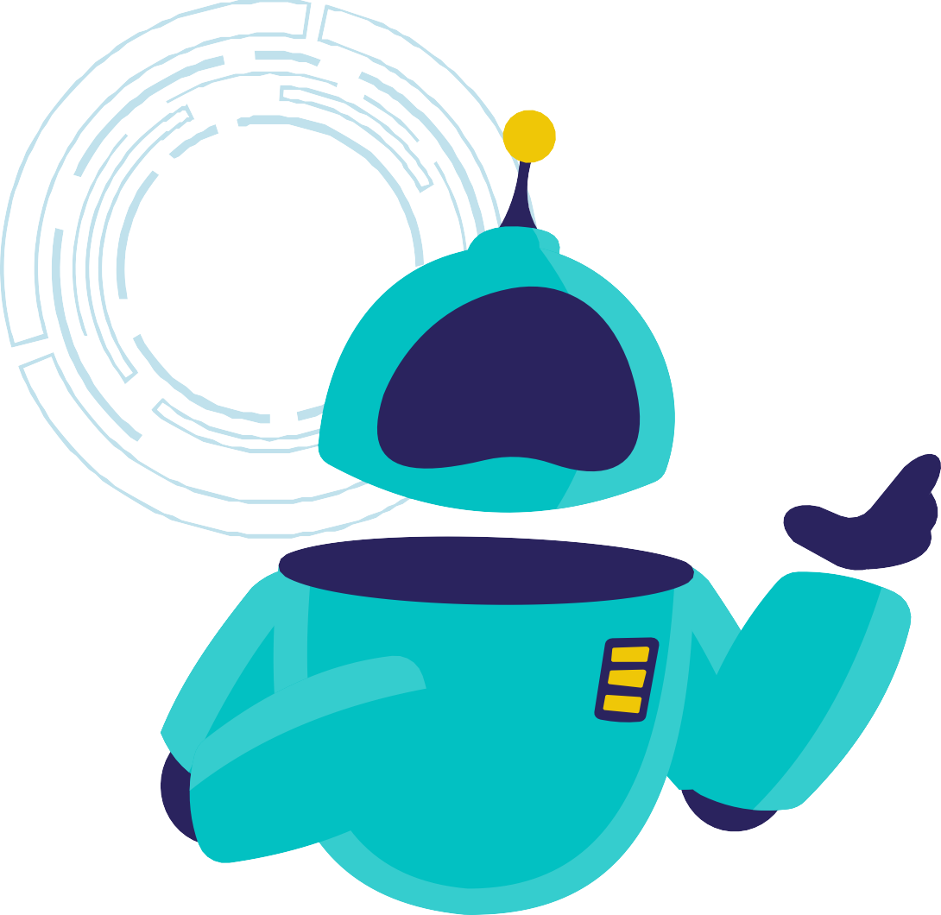



Ask your questions !!
next slide

Slide 18





Thank You!
Thank you for exploring the world of AI with us

